Slide 1
Incremental Shortest Path
Xi Lin
Department of Mechanical Engineering
Stevens Institute of Technology

Slide 2
Introduction
All-pair shortest path (APSP) problem
Given a graph (V,E), where V, E are the set of vertices and edges respectively. APSP problem requires solving the shortest path from the vertex i to j, where i, j are arbitrary elements from V.
Brute force solution
Recompute the shortest path for every pair of vertices each time, e.g., Floyd Warshall algorithm [1].
Dynamic solution
Only updates the shortest path of affected pairs of vertices when the graph changes
Incremental algorithms [2-5]: only deal with vertex or edge insertion, and edge weight decrease.
Decremental algorithms [6-8]: only deal with vertex or edge deletion, and edge weight increase.
Fully dynamic algorithms [9-13]: manage both cases.

Slide 3
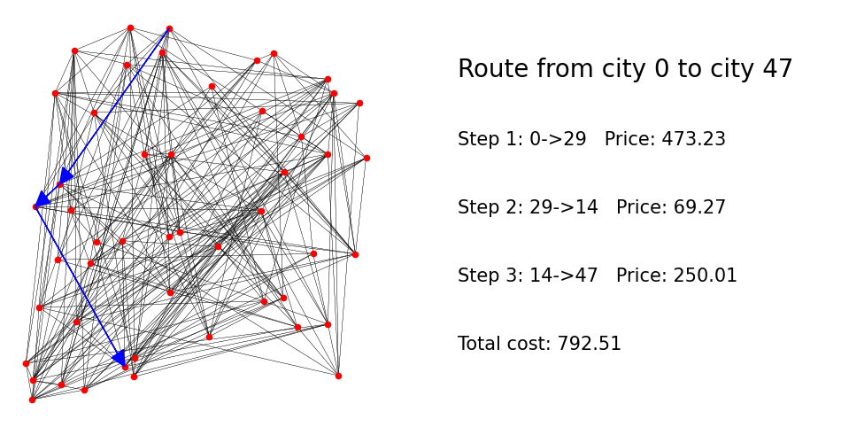
Problem Setup
Routes with the cheapest overall flight price
The vertices represent cities in a map, and edges represent currently available airlines. This project studies the effect of new edges insertion on the APSP solution (The solution of the initial map is given).

Slide 4
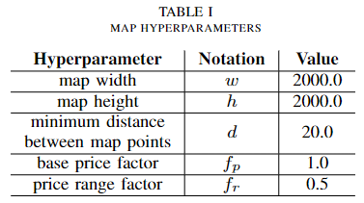
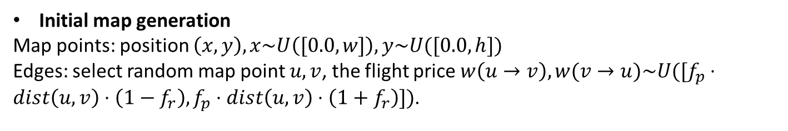
Problem Setup
Initial map generation
Map points: position $\left(x,y\right), x\sim U\left([0.0,w]\right), y\sim U([0.0,h])$
Edges: select random map point $u,v$, the flight price $w\left(u→v\right),w(v→u)\sim U([f_{p}⋅dist\left(u,v\right)⋅\left(1−f_{r}\right),f_{p}⋅dist\left(u,v\right)⋅\left(1+f_{r}\right)])$.

Slide 5
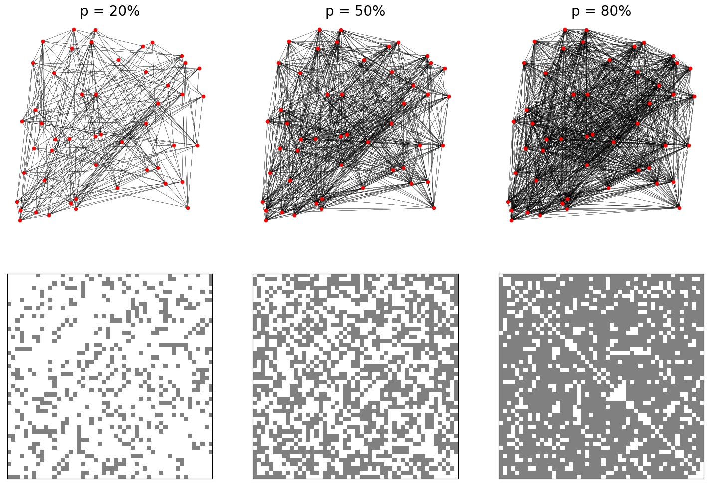
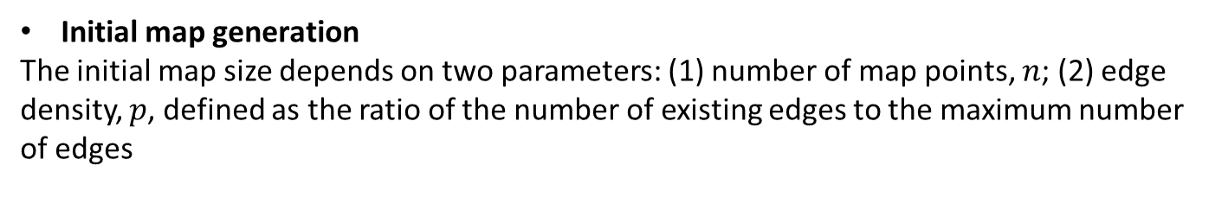
Problem Setup
Initial map generation
The initial map size depends on two parameters: (1) number of map points, $n$; (2) edge density, $p$, defined as the ratio of the number of existing edges to the maximum number of edges
n=50

Slide 6
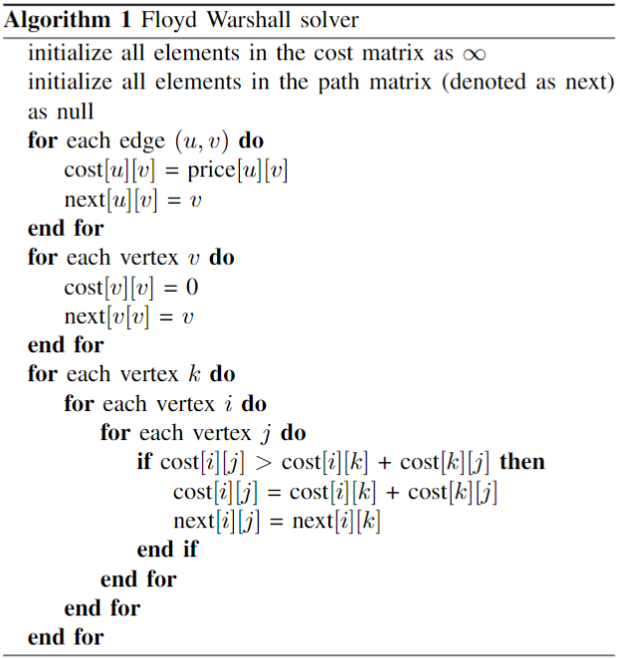
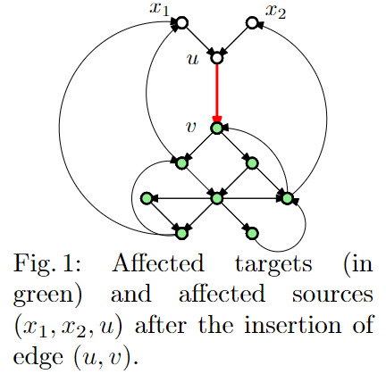
Problem Setup
Solutions
The Floyd Warshall algorithm and the incremental algorithm from [2] are implemented and used in experiments. The idea of the incremental algorithm is shown in Fig. 1.

Slide 7
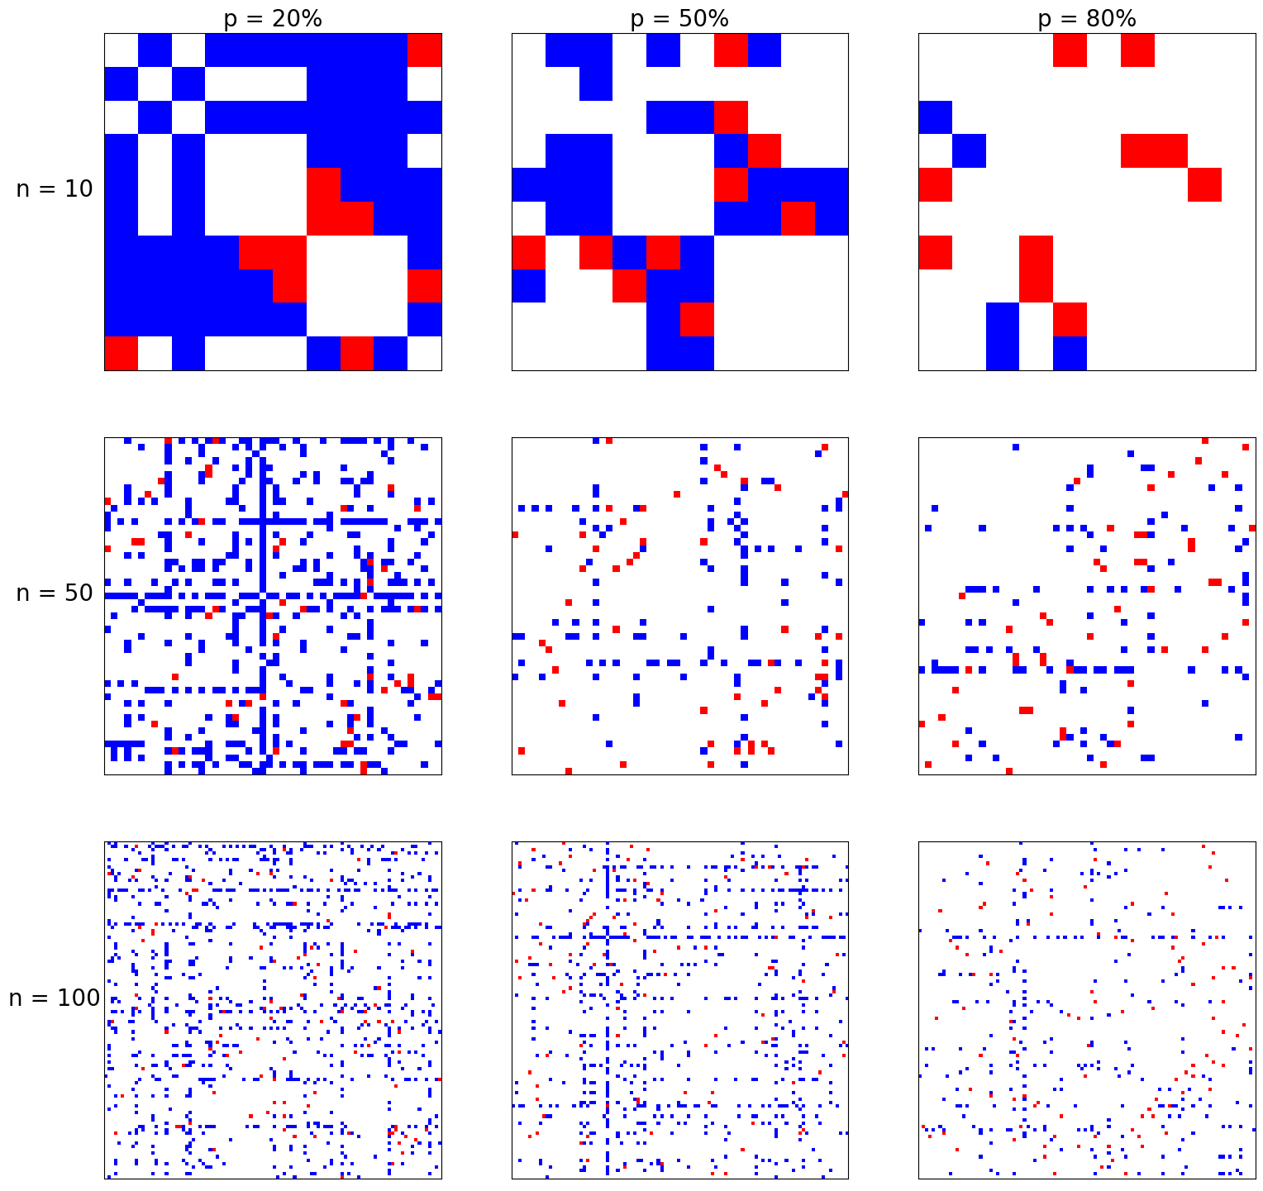
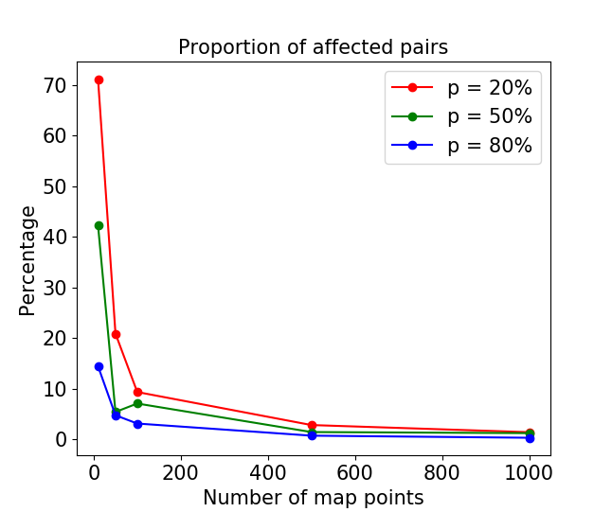

Experiment
Incremental solver performance
Initial maps with $n$ = 10, 50, 100, 500, 1000, and $p$ = 20%, 50%, 80%. The number of newly inserted edges (red blocks) is $\frac{n}{2}.$The affected pairs of map points are shown in blue blocks.

Slide 8
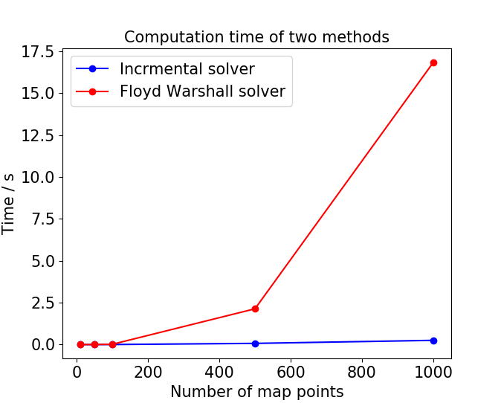
Experiment
Incremental solver vs Floyd Warshall solver
To update the routes of cheapest price in the map of 1000 map points when 500 new edges are inserted, the computation time of the Floyd Warshall solver is over 16 seconds, while the incremental solver only needs less than 0.5 seconds.

Slide 9
References
[1] Cormen, T. H., Leiserson, C. E., Rivest, R. L., & Stein, C. (2022). Introduction to algorithms. MIT press.
[2] Slobbe, A., Bergamini, E., & Meyerhenke, H. (2016). Faster incremental all-pairs shortest paths. KIT.
[3] Pang, C., Kotagiri, R., & Dong, G. (1999, January). Incremental FO (+,<) maintenance of all-pairs shortest paths for undirected graphs after insertions and deletions. In International Conference on Database Theory (pp. 365-382). Springer, Berlin, Heidelberg.
[4] Ramalingam, G., & Reps, T. (1996). An incremental algorithm for a generalization of the shortest-path problem. Journal of Algorithms, 21(2), 267-305.
[5] Ausiello, G., Italiano, G. F., Spaccamela, A. M., & Nanni, U. (1991). Incremental algorithms for minimal length paths. Journal of Algorithms, 12(4), 615-638.
[6] Bernstein, A. (2013, June). Maintaining shortest paths under deletions in weighted directed graphs. In Proceedings of the forty-fifth annual ACM symposium on Theory of computing (pp. 725-734).
[7] Baswana, S., Hariharan, R., & Sen, S. (2007). Improved decremental algorithms for maintaining transitive closure and all-pairs shortest paths. Journal of Algorithms, 62(2), 74-92.
[8] Baswana, S., Hariharan, R., & Sen, S. (2003, January). Maintaining all-pairs approximate shortest paths under deletion of edges. In SODA (Vol. 3, pp. 394-403).
[9] Abraham, I., Chechik, S., & Krinninger, S. (2017). Fully dynamic all-pairs shortest paths with worst-case update-time revisited. In Proceedings of the Twenty-Eighth Annual ACM-SIAM Symposium on Discrete Algorithms (pp. 440-452). Society for Industrial and Applied Mathematics.
[10] Demetrescu, C., & Italiano, G. F. (2006). Fully dynamic all pairs shortest paths with real edge weights. Journal of Computer and System Sciences, 72(5), 813-837.
[11] Thorup, M. (2004, July). Fully-dynamic all-pairs shortest paths: Faster and allowing negative cycles. In Scandinavian Workshop on Algorithm Theory (pp. 384-396). Springer, Berlin, Heidelberg.
[12] Demetrescu, C., & Italiano, G. F. (2004). A new approach to dynamic all pairs shortest paths. Journal of the ACM (JACM), 51(6), 968-992.
[13] Henzinger, M. R., Klein, P., Rao, S., & Subramanian, S. (1997). Faster shortest-path algorithms for planar graphs. journal of computer and system sciences, 55(1), 3-23.

